Slide 1
Horizon 2014: What LGBTI Rights in the EU? Silvan Agius
LGBT Intergroup Roundtable
European Parliament, Brussels 8 December 2011

Slide 2
Be Bothered Campaign 2009
Pledge
signed by
139
MEPs

Slide 3
European Election Pledge 2009-2014
1
Equal treatment
legislation
10
Commitment
towards equality
2
Freedom of
movement
9
EU Commission
commitment
3
Recognition of trans
people’s rights
8
LGBT rights
in the world
4
Legislation combating
homo- & transphobia
7
LGBT rights
beyond the EU
5
Inclusive family
definition
6
EU’s fundamental
rights watchdog

Slide 4
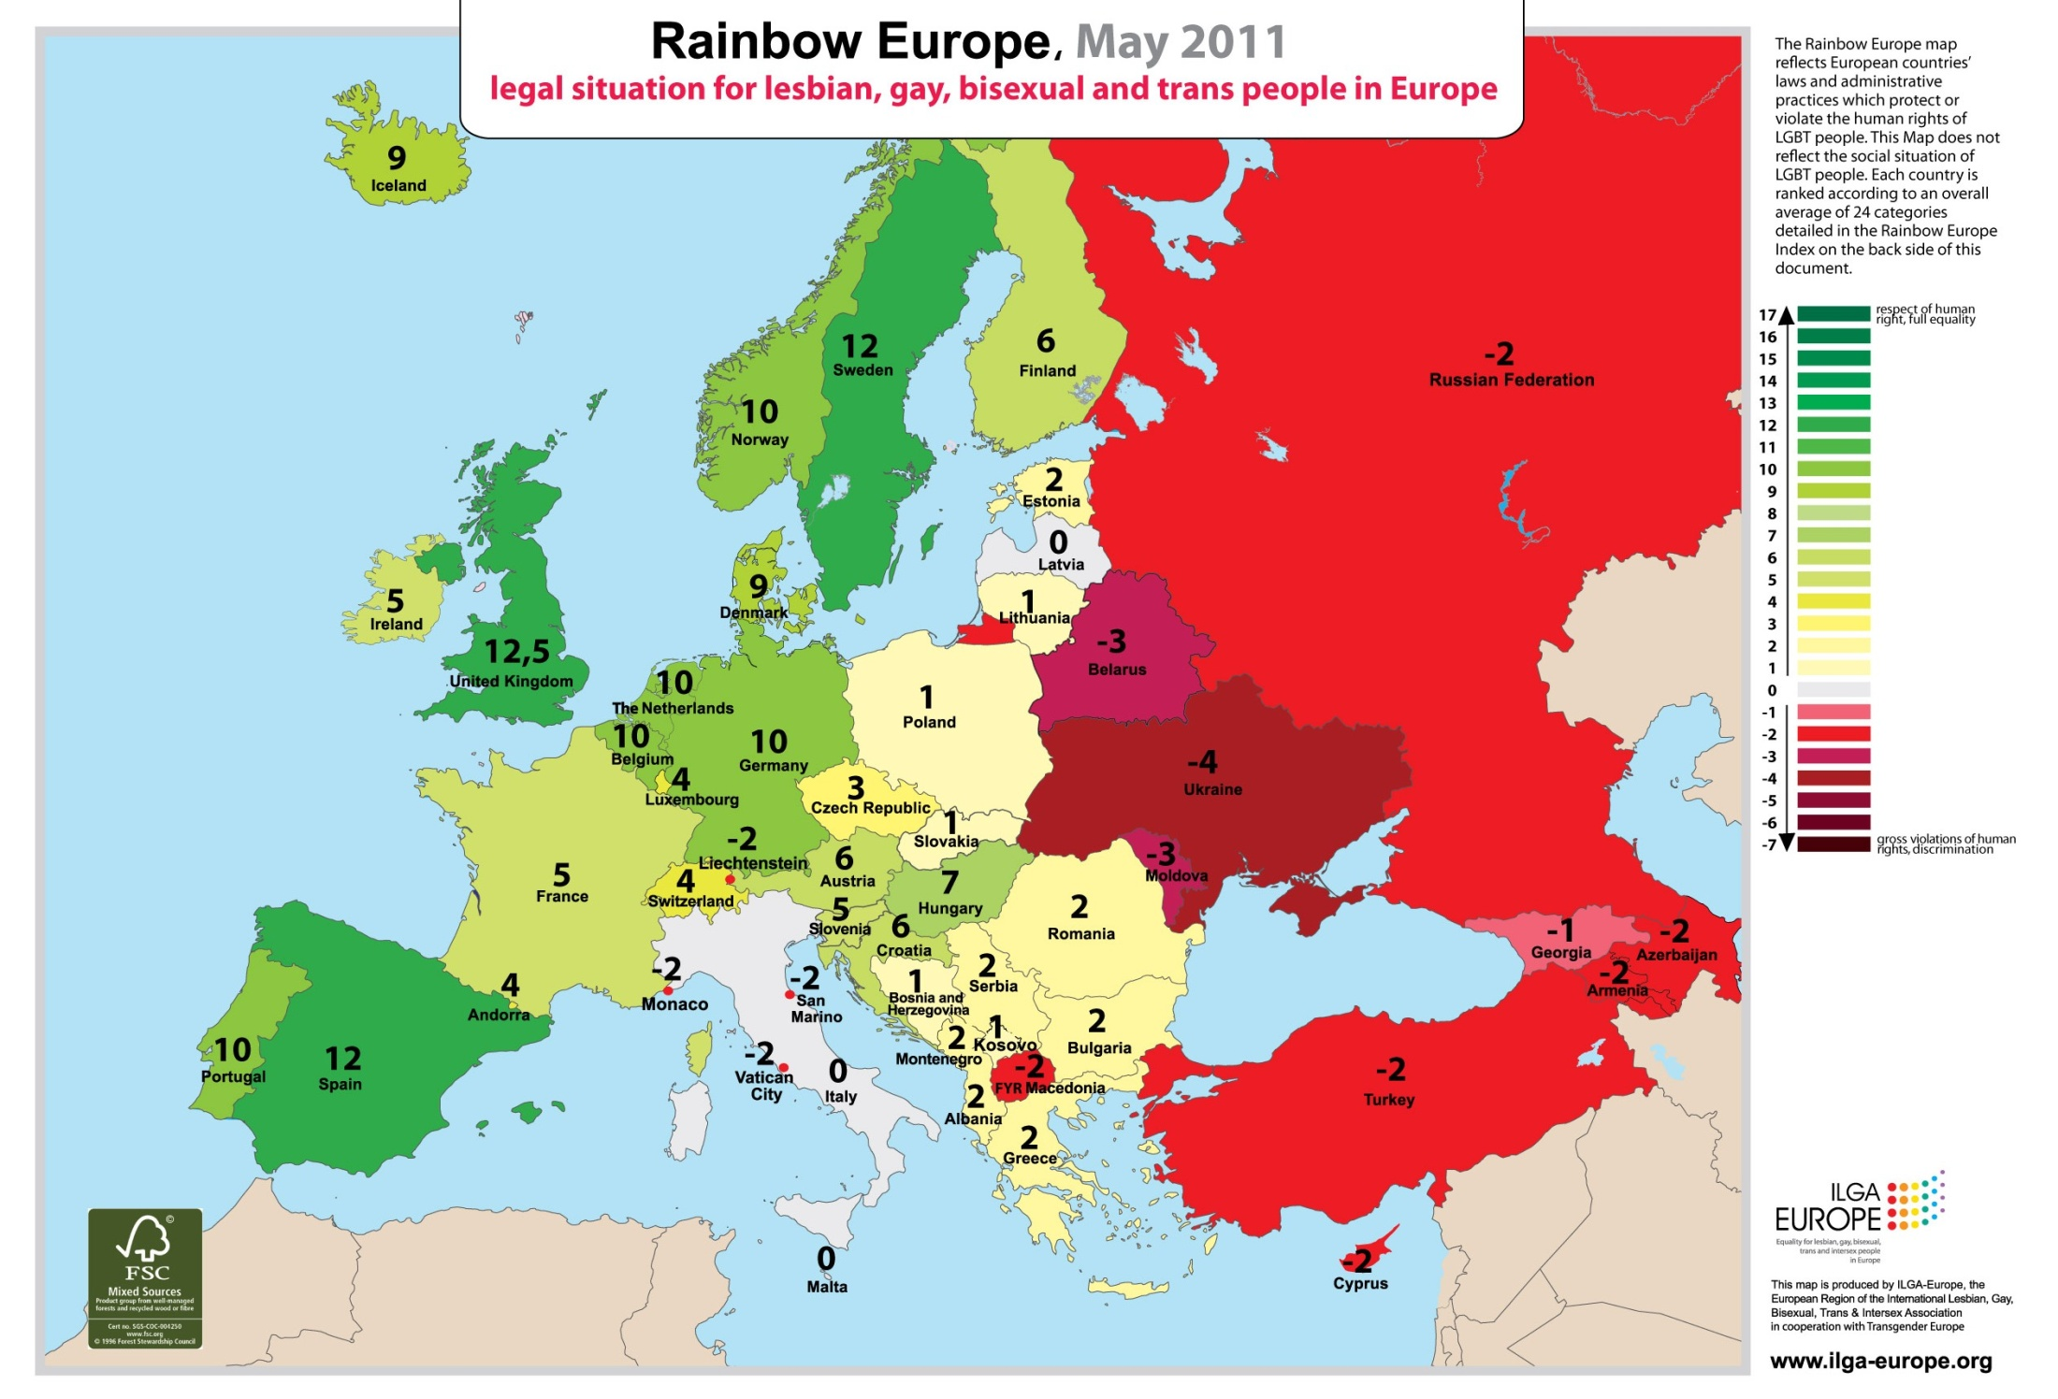

Slide 5
>> Destination
2014

Slide 6
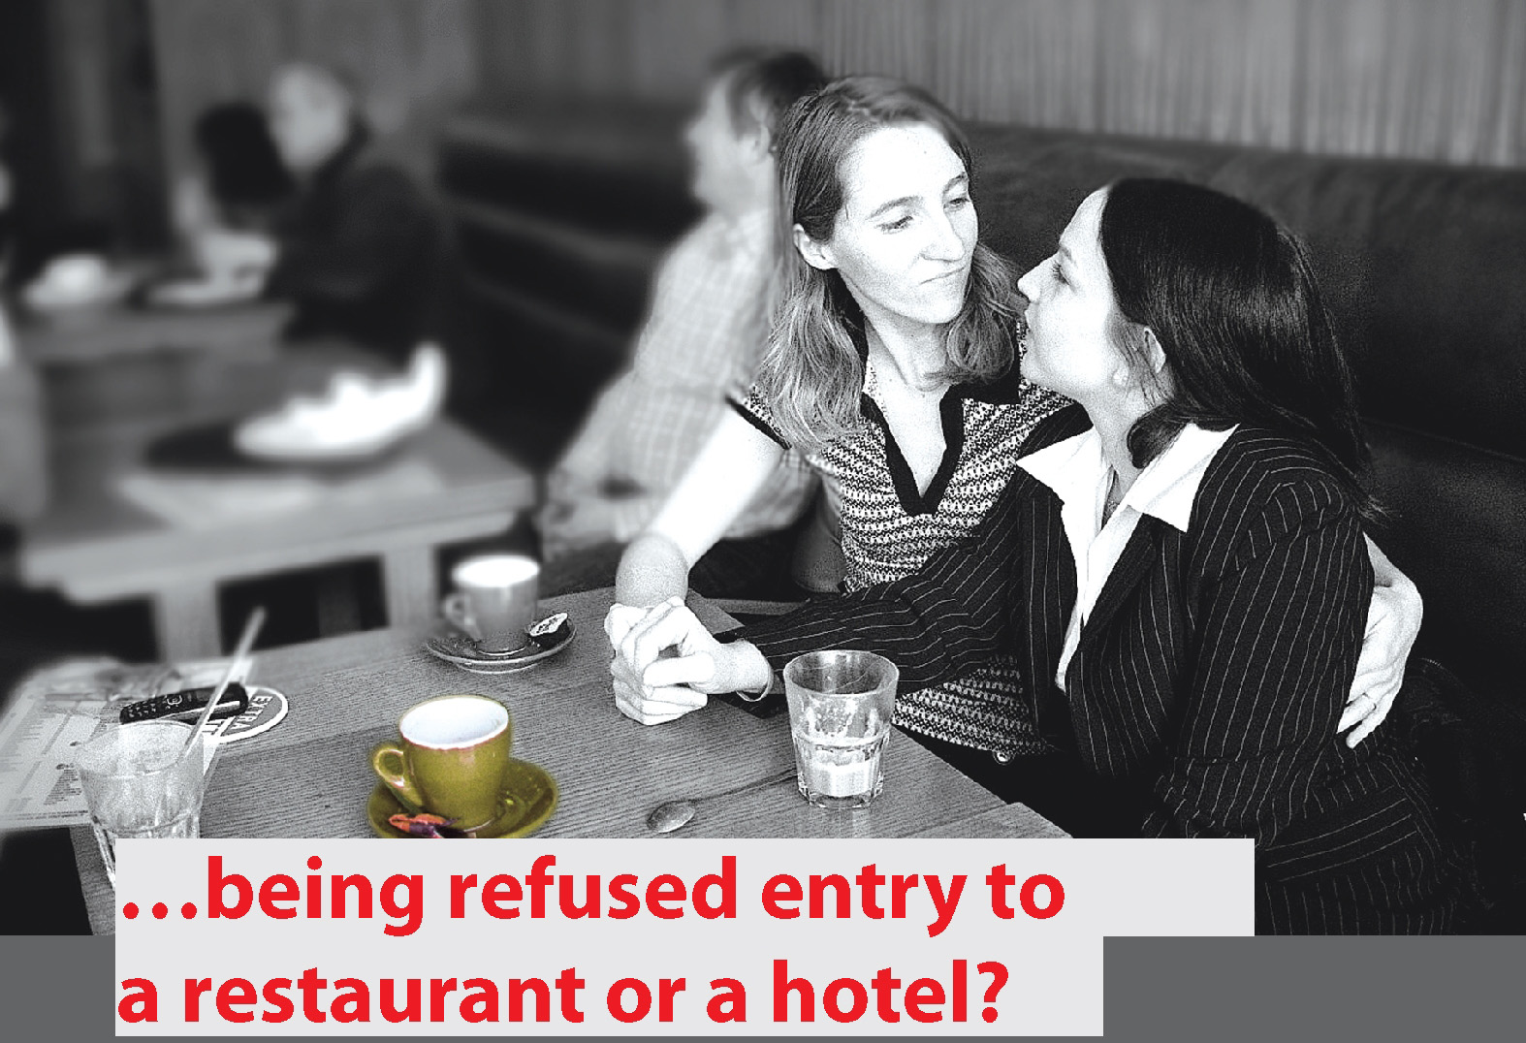
1. Adoption of Anti-Discrimination Directive

Slide 7
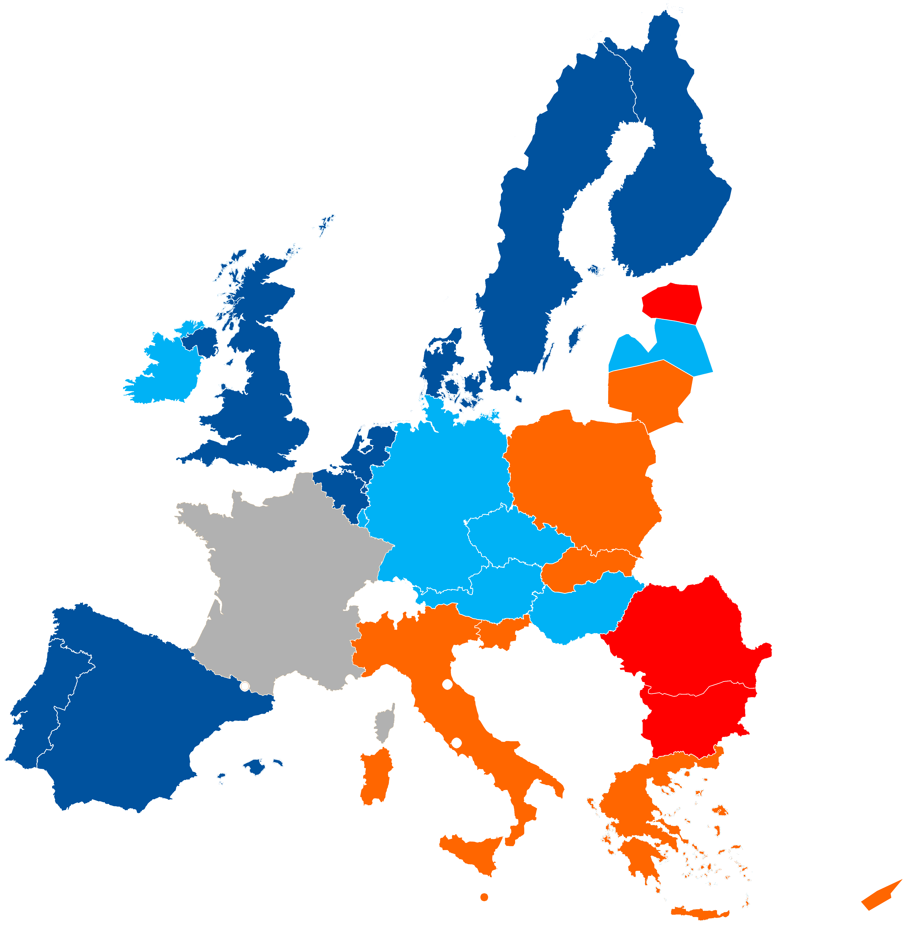
2. Free Movement & Mutual Recognition
Right to freedom of
movement of same-sex
couples within the EU*:
Spouses & partners 8
Partners only 7
No recognition 8
Ban on recognition 3
(France unclear)
*Based on FRA 2010 Update

Slide 8
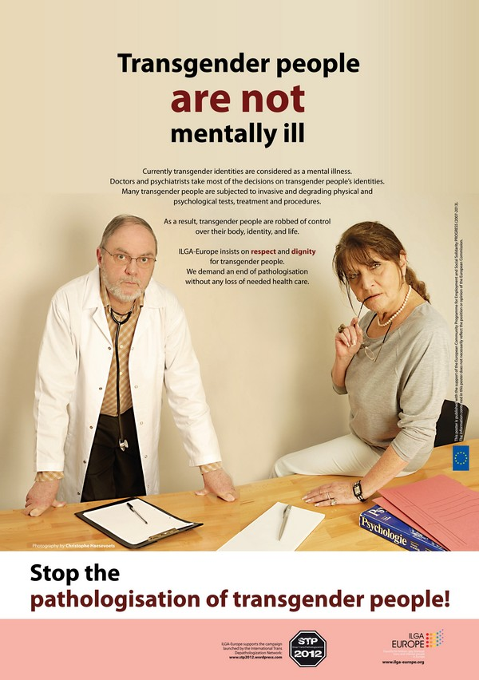
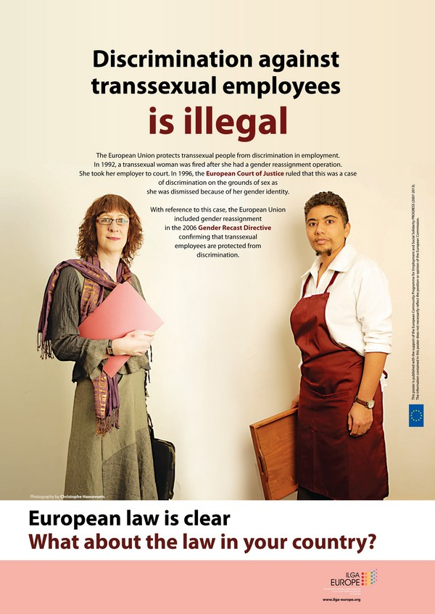
3. Recognition of trans people’s rights

Slide 9
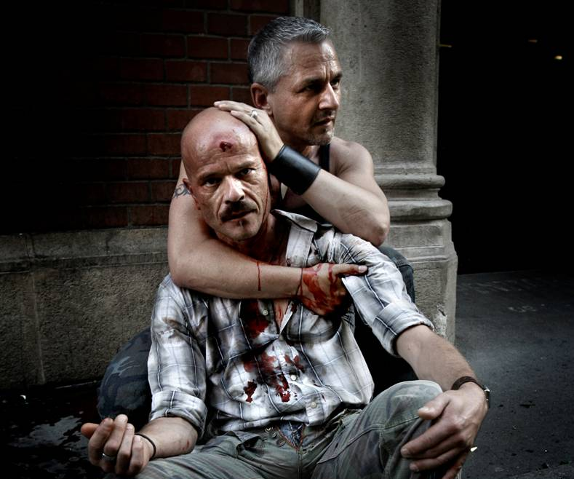
4. Criminal law against LGBTIphobia

Slide 10
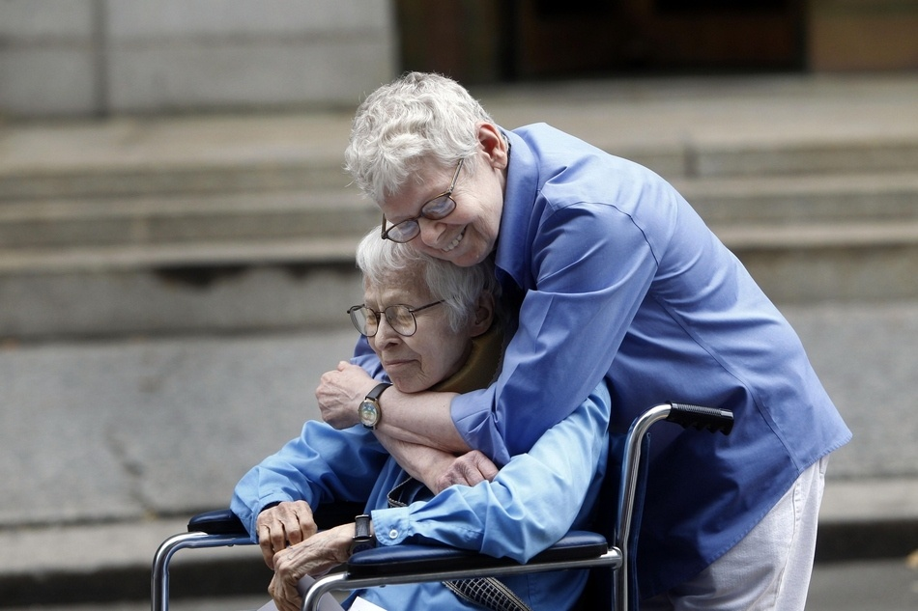
5. Inclusive definition of family

Slide 11
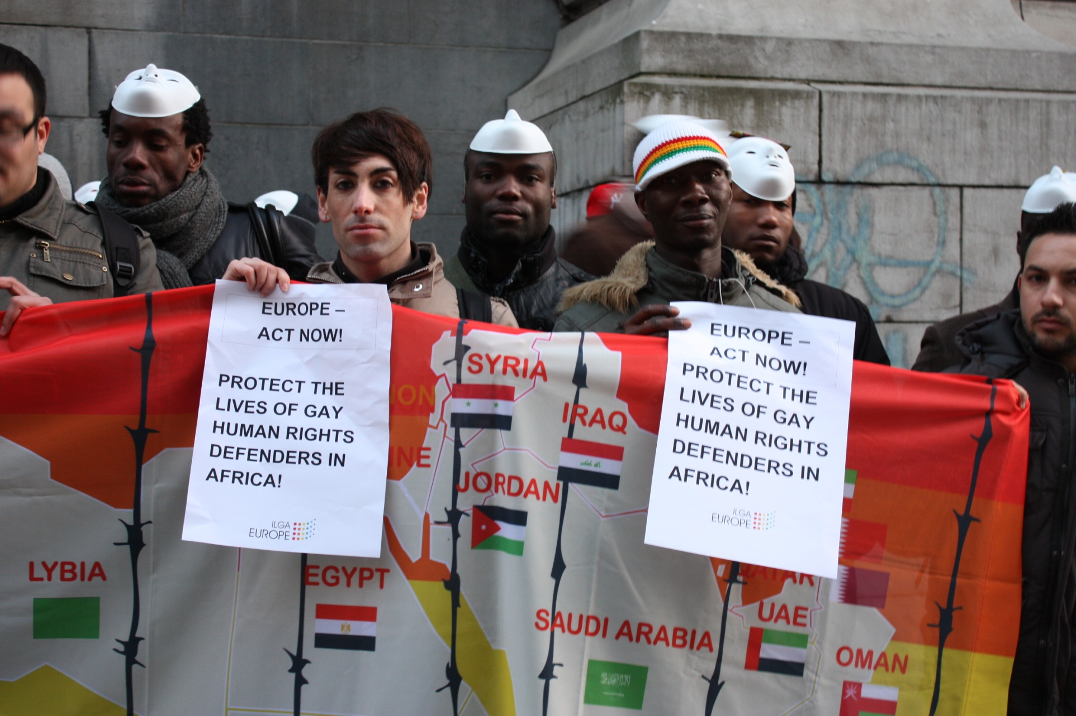
6. Asylum package

Slide 12
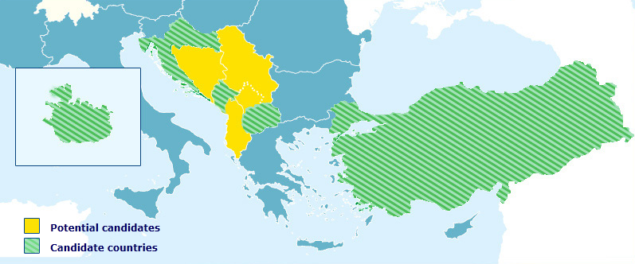
7. Accession & neighbouring countries

Slide 13
>> LGBTI
Roadmap

Slide 14
Why is a Roadmap needed?
EU misses a coherent approach towards LGBTI issues
A hierarchy of recognition and rights still remains within the EU
A roadmap will help to facilitate mainstreaming (Charter + Art 10 TFEU obligations)

Slide 15
What will the LGBTI Roadmap look like?
ILGA-Europe sees the roadmap as a tool that:
Brings together all EU LGBTI equality actions into one package
Addresses the recommendations made by FRA as well as CoE CM & HRC
Makes progress towards equality measurable

Slide 16
Thank you silvan@ilga-europe.org

